Slide 1
Learning from Observations

Slide 2
Outline
Learning agents
Inductive learning
Decision tree learning

Slide 3

Learning?
"Learning is making useful changes in our minds."
Marvin Minsky
Notes:
Professor of EE and CS, MIT Media Lab, MIT AI Lab, Cambridge, MA
Marvin Minsky has made many contributions to AI, cognitive psychology, mathematics, computational linguistics, robotics, and optics. In recent years he has worked chiefly on imparting to machines the human capacity for commonsense reasoning. His conception of human intellectual structure and function is presented in The Society of Mind .

Slide 4

Learning?
"Learning is constructing or modifying representations of what is being experienced."
Ryszard Michalski
Notes:
Professor of Computational Sciences, Director of the Machine Learning and Inference Laboratory, George Mason University, Fairfax, VA
Dr. Michalski is a cofounder of the field of machine learning, and the originator of several research subareas, such as conceptual clustering, constructive induction, variable-valued logic, natural induction, variable-precision logic (with Patrick Winston, MIT), computational theory of human plausible reasoning (with Alan Collins), two-tiered representation of imprecise concepts, multistrategy task-adaptive learning, inferential theory of learning, learnable evolution model, and, most recently, inductive databases and knowledge scouts.

Slide 5
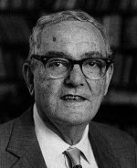
Learning?
"Learning denotes changes in a system that ... enable a system to do the same task more efficiently the next time."
Herbert Simon
1916 - 2001
Notes:
1916-2001 , Professor of Psychology, CMU, Pittsburgh, PA
Herbert Simon's main interests in computer science were in artificial intelligence, human-computer interaction, principles of the organization of humans and machines is information processing systems, the use of computers to study (by modeling) philosophical problems of the nature of intelligence and of epistemology, and the social implications of computer technology.

Slide 6
Learning
Learning is essential for unknown environments,
i.e., when designer lacks omniscience
Learning is useful as a system construction method,
i.e., expose the agent to reality rather than trying to write it down
Learning modifies the agent's decision mechanisms to improve performance

Slide 7
Why do machine learning?
Understand and improve efficiency of human learning
Use to improve methods for teaching and tutoring people, as done in CAI -- Computer-aided instruction
Discover new things or structure that is unknown to humans
Data mining
Fill in skeletal or incomplete specifications about a domain
Large, complex AI systems cannot be completely derived by hand and require dynamic updating to incorporate new information.
Learning new characteristics expands the domain or expertise and lessens the "brittleness" of the system

Slide 8
Components of a Old Agent
Agent
Environment
Sensors
Model of World (being updated)
Prior Knowledge about the World
Reasoning & Decisions Making
Effectors
List of Possible Actions
Goals/Utility

Slide 9
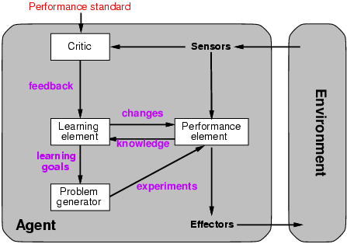
Learning agents

Slide 10
Components of a Learning Agent
Environment
Sensors
Performance
Element
Effectors

Slide 11
Components of a Learning Agent
LE changes PE based on how it is doing
PE provides knowledge to LE
Environment
Sensors
Performance
Element
Learning Element
Effectors

Slide 12
Components of a Learning Agent
C provides feedback to LE on how PE is doing
C compares PE with a standard of performance that’s told (via sensors)
Environment
Sensors
Critic
Performance
Element
Learning Element
Effectors
Notes:
e.g. feedback of success or failure

Slide 13
Components of a Learning Agent
PG suggests problems or actions to PE that will generate new examples or experiences
that will aid in achieving the goals from the LE
Environment
Learning Agent
Sensors
Critic
Performance
Element
Learning Element
Effectors
Problem Generator

Slide 14
Components of a Learning Agent
Environment
Learning Agent
Sensors
Critic
Performance
Element
Learning Element
Effectors
Problem Generator
Notes:
We'll concentrate on the LE.

Slide 15
Learning element
Design of a learning element is affected by
Which components of the performance element are to be learned
What feedback is available to learn these components
What representation is used for the components
Type of feedback:
Supervised learning: correct answers for each example
Unsupervised learning: correct answers not given
Reinforcement learning: occasional rewards

Slide 16
Inductive learning
Simplest form: Learn a function from examples
Extrapolates from a given set of examples so that accurate predictions can be made about future examples.
f is the target function
An example is a pair (x, f(x)) Problem: find a hypothesis h
such that h ≈ f
given a training set of examples

Slide 17
Supervised vs. Unsupervised learning
Supervised:
"teacher" gives a set of both the input examples and desired outputs, i.e. (x, f(x)) pairs
Unsupervised:
only given the input examples, i.e. the x
In either case, the goal is to determine an hypothesis h that estimates f.

Slide 18
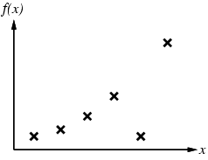
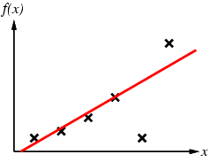
Inductive learning method
Construct/adjust h to agree with f on training set (h is consistent if it agrees with f on all examples)
E.g., curve fitting:

Slide 19
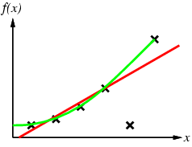
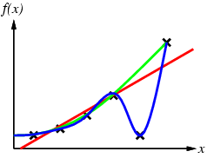
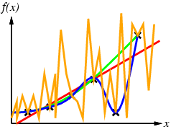
Inductive learning method: Curve fitting
Ockham’s razor: prefer the simplest hypothesis consistent with data

Slide 20
Learning decision tree

Slide 21
Learning decision trees
Problem: decide whether to wait for a table at a restaurant, based on the following attributes:
Alternate: is there an alternative restaurant nearby?
Bar: is there a comfortable bar area to wait in?
Fri/Sat: is today Friday or Saturday?
Hungry: are we hungry?
Patrons: number of people in the restaurant (None, Some, Full)
Price: price range ($, $$, $$$)
Raining: is it raining outside?
Reservation: have we made a reservation?
Type: kind of restaurant (French, Italian, Thai, Burger)
WaitEstimate: estimated waiting time (0-10, 10-30, 30-60, >60)

Slide 22
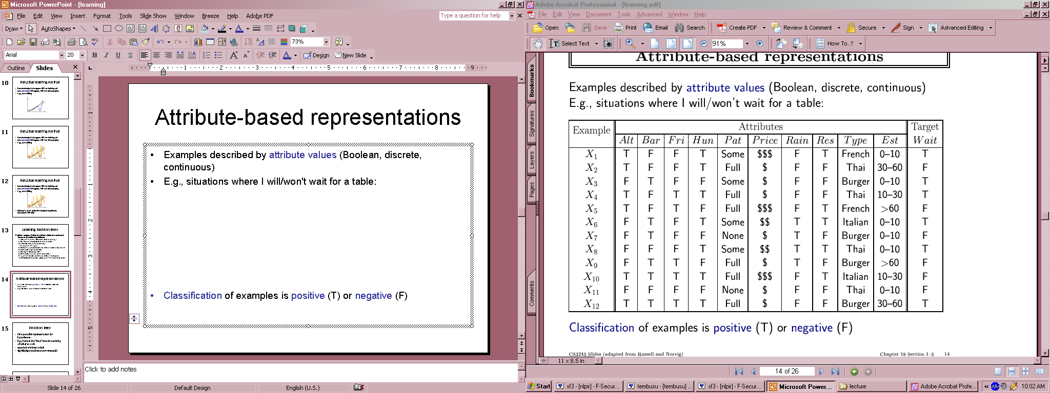
Attribute-based representations
Examples described by attribute values (Boolean, discrete, continuous)
E.g., situations where I will/won't wait for a table:
Classification of examples is positive (T) or negative (F)

Slide 23
How to summarize data
Idea: Try to capture the logical structure of the data.
Create a node for some feature, with a descendent for each value,
repeat at each node for a different feature,
until we can reach a decision.
Such an object is called a decision tree.
Seems almost ridiculously simple, but turns out to be extremely useful way to summarize data.

Slide 24
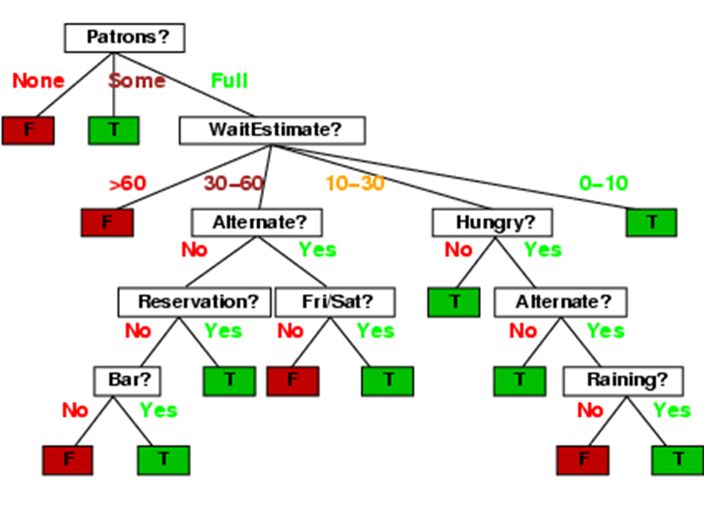
Decision trees
One possible representation for hypotheses
E.g., here is the “true” tree for deciding whether to wait:

Slide 25
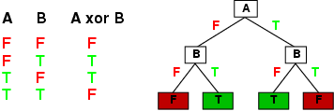
Expressiveness
Decision trees can express any function of the input attributes.
E.g., Boolean functions, truth table row → path to leaf:
Trivially, there is a consistent decision tree for any training set with one path to leaf for each example (unless f nondeterministic in x) but it probably won't generalize to new examples
Prefer to find more compact decision trees

Slide 26
Decision tree
We can always come up with some decision tree for a data set:
Pick any feature not used yet, branch on its values, continue.
However, starting with a random feature may lead to a large, unmotivated tree.
In general, we prefer short trees over larger ones.
Why?!
Intuitively, a simple (consistent) hypothesis is more likely to be true.

Slide 27
Hypothesis spaces
How many distinct decision trees with n Boolean attributes?
= number of Boolean functions
= number of distinct truth tables with 2^{n} rows = E.g., with 6 Boolean attributes, there are 18,446,744,073,709,551,616 trees
How many purely conjunctive hypotheses (e.g., Hungry ∧ ¬Rain)?
Each attribute can be in (positive), in (negative), or out
⇒ 3^{n} distinct conjunctive hypotheses
More expressive hypothesis space
increases chance that target function can be expressed
increases number of hypotheses consistent with training set
⇒ may get worse predictions

Slide 28
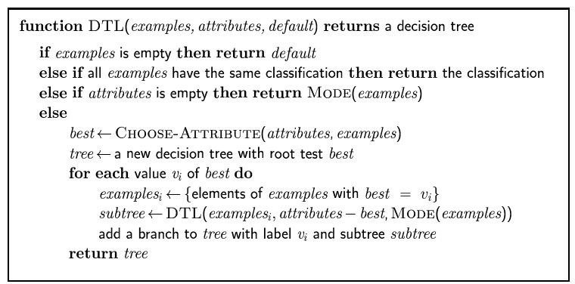
Decision tree learning
Aim: find a small tree consistent with the training examples
Idea: (recursively) choose "most significant" attribute as root of (sub)tree

Slide 29
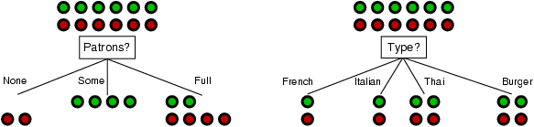
Choosing an attribute
Idea: a good attribute splits the examples into subsets that are (ideally) "all positive" or "all negative"
Patrons? is a better choice

Slide 30
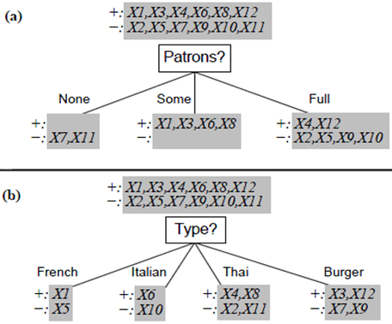
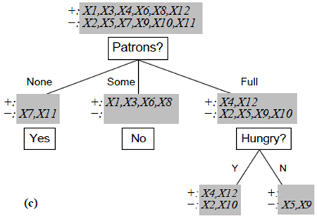

Slide 31
Choosing an attribute
Finding the smallest decision tree turns out to be intractable.
However, there are simple heuristics that do a good job of finding small trees.
Basic question is: Which attribute do we split on next?
Idea: Using information theory
Define a statistical property, called information gain, to measure how good a feature is at separating the data according to the target.

Slide 32
Attribute Selection Measure: Information Gain (ID3/C4.5)
Select the attribute with the highest information gain
Let p_{i} be the probability that an arbitrary tuple in D belongs to class C_{i}, estimated by |C_{i, D}|/|D|
Expected information (entropy) needed to classify a tuple in D:
Information needed (after using A to split D into v partitions) to classify D:
Information gained by branching on attribute A
Notes:
I : the expected information needed to classify a given sample
E (entropy) : expected information based on the partitioning into subsets by A

Slide 33
Information theory - Entropy
Information Content (Entropy):
Suppose A is a random variable. Then
Where
a_{i} is a possible value of A
P(a_{i}) is is the probability of A = a_{i}
For a training set D containing p positive examples and n negative
For 12 restaurant examples, wait p = 6, nowait n = 6

Slide 34
Information gain
A chosen attribute A divides the training set D into subsets D₁, … , D_{v} according to their values for A, where A has v distinct values.
Let D_{i} have p_{i} positive and n_{i} negative examples
⇒ entropy(D_{i}) = I(p_{i}, n_{i}) bits needed to classify a new example
⇒ expected number of bits per example over all branches is

Slide 35
Information gain
Information Gain (IG) or reduction in entropy from the attribute test:
Choose the attribute with the largest IG

Slide 37
Information gain
For the training set D, p = n = 6, Entropy(D) = I(6, 6) = 1 bit
Consider the attributes Patrons and Type:
Patrons has the highest IG of all attributes and so is chosen by the DTL algorithm as the root

Slide 38
Attribute-based representations
Examples described by attribute values (Boolean, discrete, continuous)
E.g., situations where I will/won't wait for a table:
Classification of examples is positive (T) or negative (F)

Slide 39
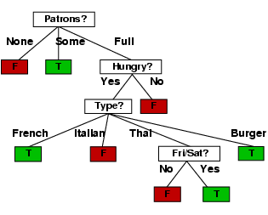
Example contd.
Decision tree learned from the 12 examples:
Substantially simpler than “true” tree---a more complex hypothesis isn’t justified by small amount of data

Slide 40
Extract Rules from Decision Tree
If Patrons = None then NoWait
If Patrons = Some then Wait
If (Patrons = Full and Hungry = No) then NoWait
If (Patrons = Full and Hungry = Yes and Type = French) then Wait
If (Patrons = Full and Hungry = Yes and Type = Italian) then NoWait
If (Patrons = Full and Hungry = Yes and Type = Burger) then Wait
If (Patrons = Full and Hungry = Yes and Type = Thai and Fri = Yes) then Wait
If (Patrons = Full and Hungry = Yes and Type = Thai and Fri = No) then NoWait

Slide 41
Attribute Selection: Information Gain

Slide 42
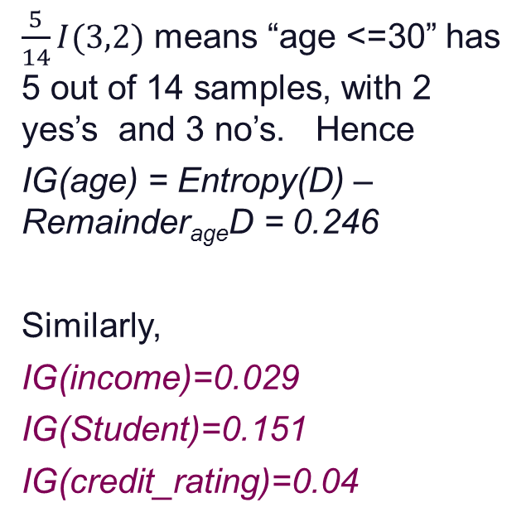
Attribute Selection: Information Gain
Class P: buys_computer = “yes”
Class N: buys_computer = “no”
$\frac{5}{14}I(3,2)$ means “age <=30” has 5 out of 14 samples, with 2 yes’s and 3 no’s. Hence
IG(age) = Entropy(D) – Remainder_{age}D = 0.246
Similarly,
IG(income)=0.029
IG(Student)=0.151
IG(credit_rating)=0.04

Slide 43
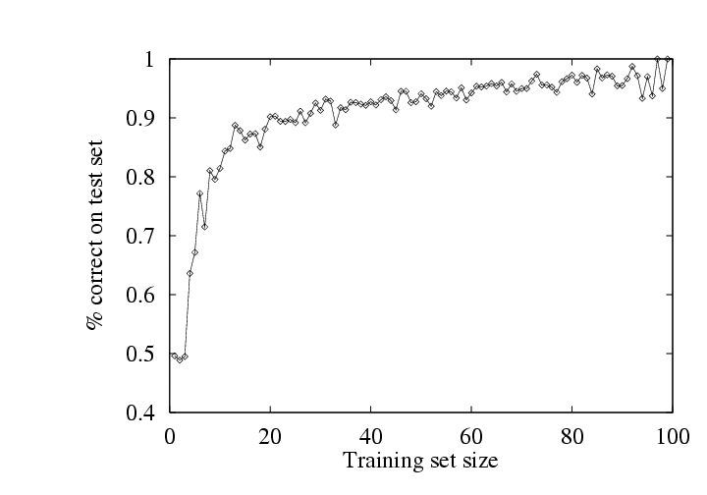
Performance measurement
How do we know that h ≈ f ?
Use theorems of computational/statistical learning theory
Try h on a new test set of examples
(use same distribution over example space as training set)
Learning curve = % correct on test set as a function of training set size

Slide 44
Summary
Learning needed for unknown environments, lazy designers
Learning agent = performance element + learning element
For supervised learning, the aim is to find a simple hypothesis approximately consistent with training examples
Decision tree learning using information gain
Learning performance = prediction accuracy measured on test set

